Slide 1
12/11

Slide 2
ViT small demo
With freezing layer:
Training accuracy: 68.7%, Loss: 0.075
Testing accuracy: 67.0056%, Loss: 0.60904349
Without freezing layer:
Training accuracy: 88.5 %, Loss: 0.029
Testing accuracy: 77.8531%, Loss: 0.72010663

Slide 3
4/8

Slide 4
Result
Min max normalization was applied.
Removed all the uncompleted data (missing T1 or Flare)

Slide 5
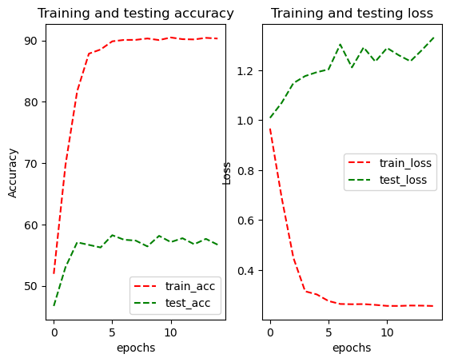
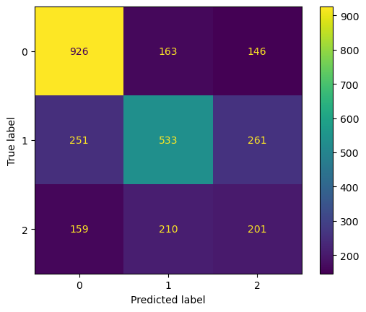
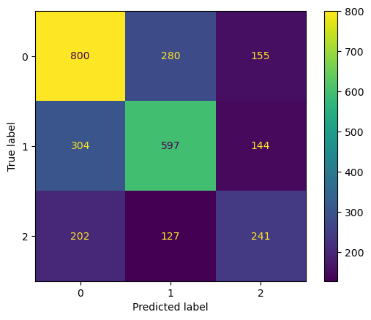
EfficientNet Result
Validat Matrix
EPOCHS = 15
LEARNING_RATE = 0.0003
BATCH_SIZE = 48
Highest Accuracy:
Training Accuracy: 89.8585%, Training Loss: 0.27595837
Validation Accuracy: 58.2456%, Validation Loss: 1.20349601
Testing Accuracy: 57.4737%, Testing Loss: 1.17209294
Test Matrix

Slide 6
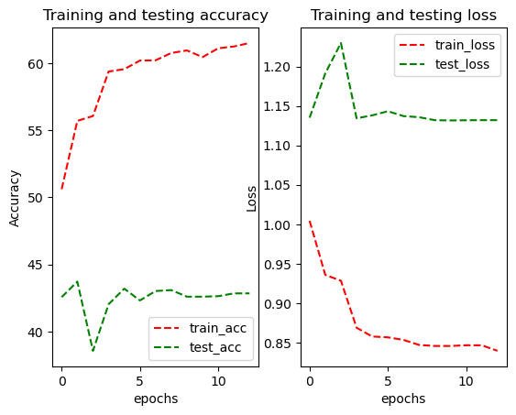
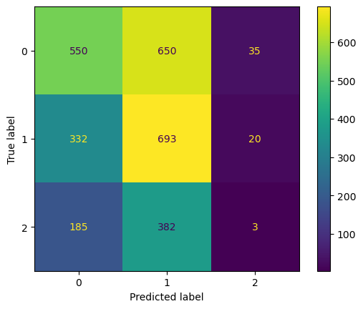
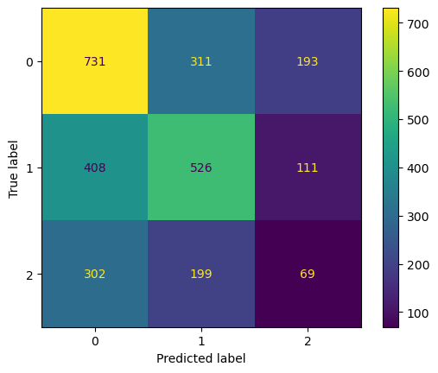
ViT Result
Validat Matrix
EPOCHS = 10
LEARNING_RATE = 0.0004
BATCH_SIZE = 48
Highest Accuracy:
Training Accuracy: 55.6989%, Training Loss: 0.93576634
Validation Accuracy: 43.7193%, Validation Loss: 1.19144470
Testing Accuracy: 45.7544%, Testing Loss: 1.08333243
Test Matrix

Slide 7
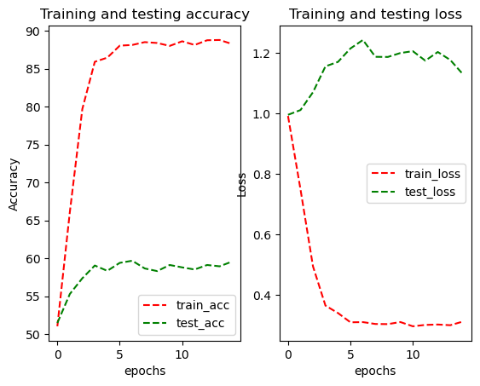
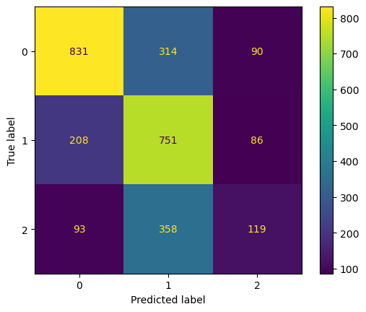
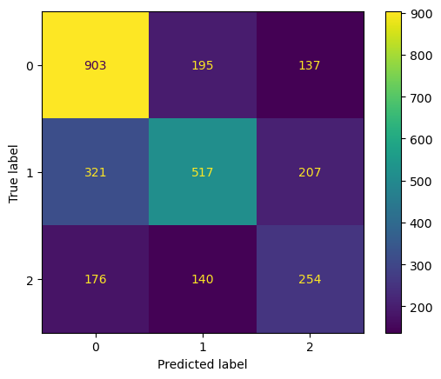
EfficientNet Result
Validate Matrix
EPOCHS = 15
LEARNING_RATE = 0.0003
BATCH_SIZE = 48
Highest Accuracy:
Training Accuracy: 88.1494%, Training Loss: 0.31102509
Validation Accuracy: 59.6842%, Validation Loss: 1.24253614
Testing Accuracy: 58.7368%, Testing Loss: 1.14878252
Test Matrix

Slide 8
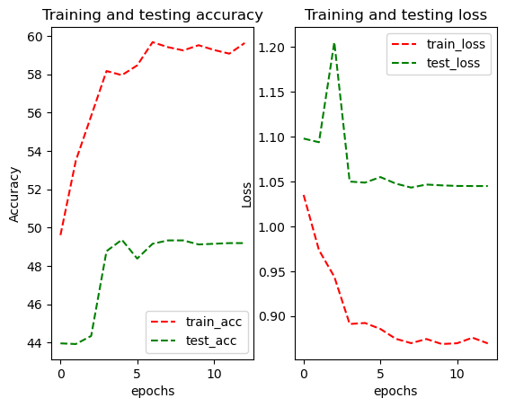
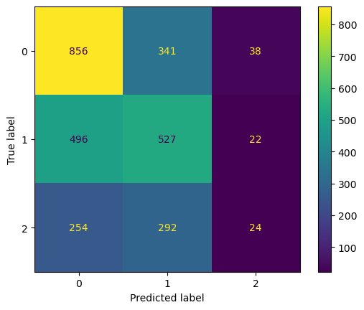
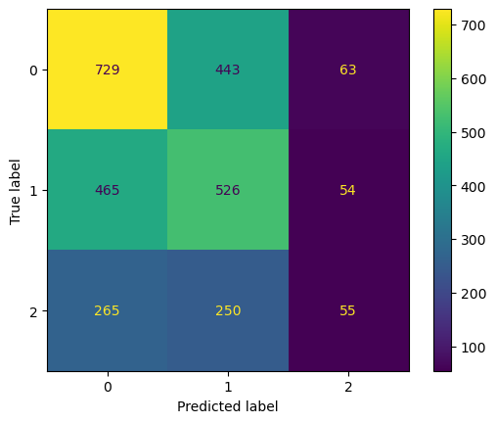
ViT Result
Validat Matrix
EPOCHS = 10
LEARNING_RATE = 0.0004
BATCH_SIZE = 48
Highest Accuracy:
Training Accuracy: 57.9513%, Training Loss: 0.89222579
Validation Accuracy: 49.3684%, Validation Loss: 1.04861604
Testing Accuracy: 45.9649%, Testing Loss: 1.08246572
Test Matrix

Slide 9
4/23

Slide 10
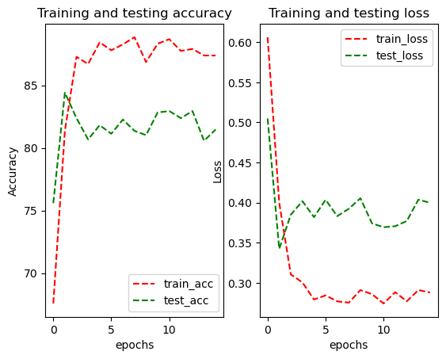
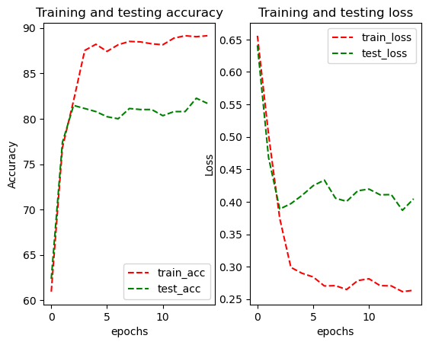
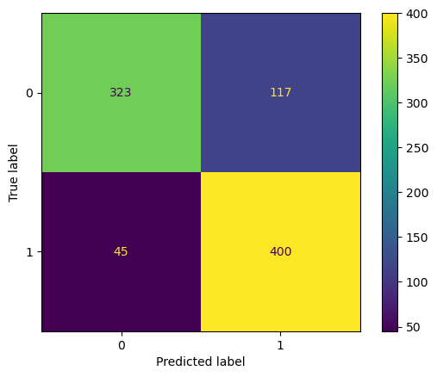
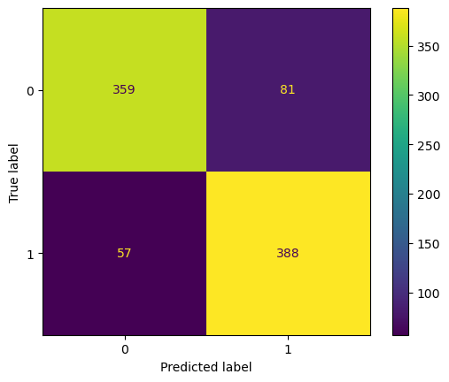
Testing code error with old dataset (SPMS vs RRMS)
Efficient Net(form old code)
Testing Accuracy: 84.4068%, Testing Loss: 0.34227082
Efficient Net(form new code)
Testing Accuracy: 81.6949%, Testing Loss: 0.40459349
Notes:
Training code does not show any error
The new result is same the old trail

Slide 11
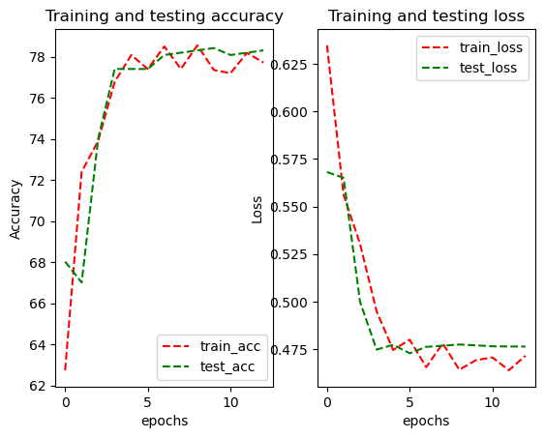
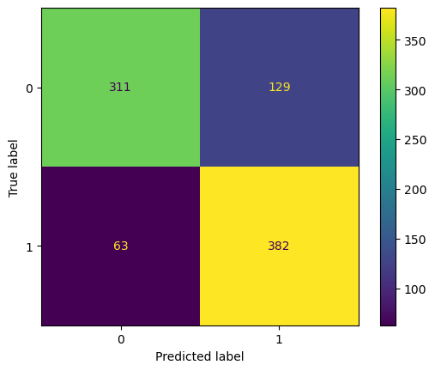
Re test old dataset(SPMS vs RRMS 10 : 9) by ViT and EffNet
Efficient Net(form new code)
Testing Accuracy: 81.6949%, Testing Loss: 0.40459349
ViT
Testing Accuracy: 78.3051%, Testing Loss: 0.47626233
Notes:
All the preprocess steps are the same, only changed the model, with the new code.
ViT model: vit_l_16(weights='ViT_L_16_Weights.IMAGENET1K_V1')

Slide 12
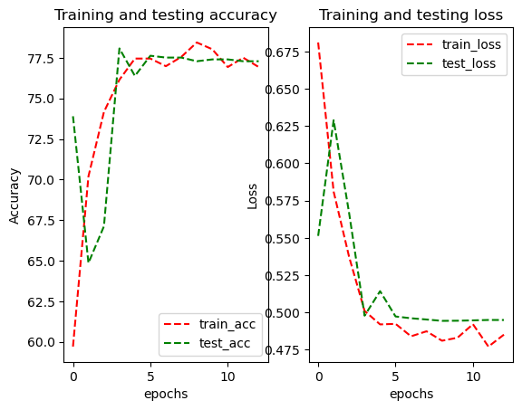
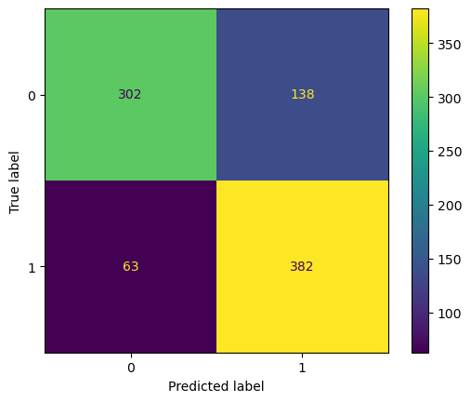
vit_l_16 vs vit_b_32
ViT
Testing Accuracy: 78.3051%, Testing Loss: 0.47626233
ViT
Testing Accuracy: 77.2881%, Testing Loss: 0.49488477
Notes:
No signicant difference between

Slide 13
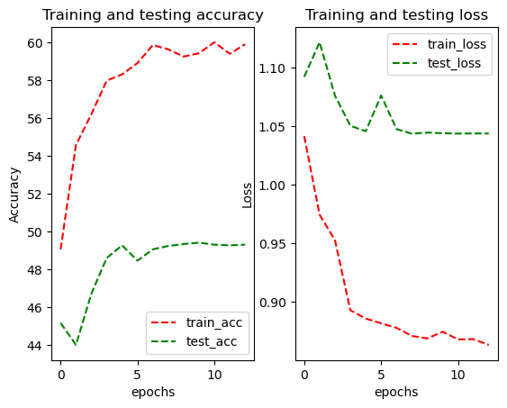
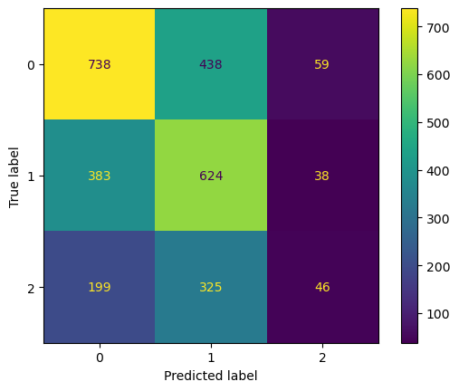
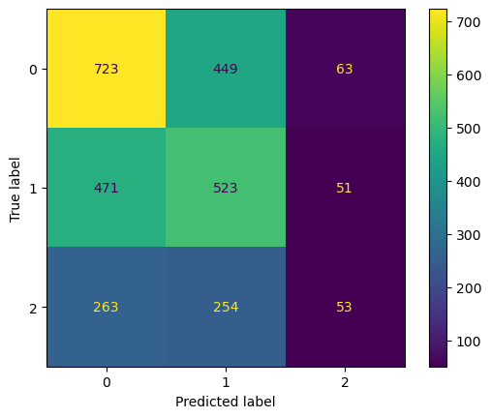
Test for new dataset (Trail 1)
ViT
Training Accuracy: 59.4227%, Training Loss: 0.87475052
Validation Accuracy: 49.4035%, Validation Loss: 1.04412205
Testing Accuracy: 45.5789%, Testing Loss: 1.08705957
Val: Test:

Slide 14
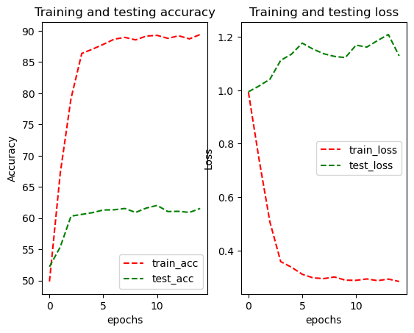
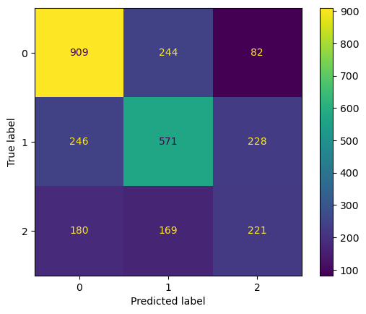
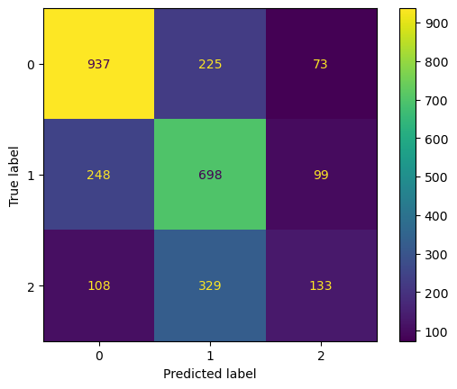
Test for new dataset (Trail 1)
Efficient Net
Training Accuracy: 89.2813%, Training Loss: 0.28849230
Validation Accuracy: 62.0351%, Validation Loss: 1.16898684
Testing Accuracy: 59.6842%, Testing Loss: 1.14959931
Val: Test:

Slide 15
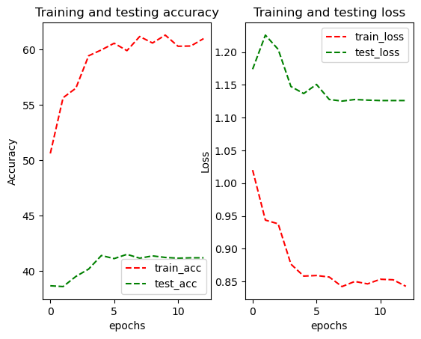
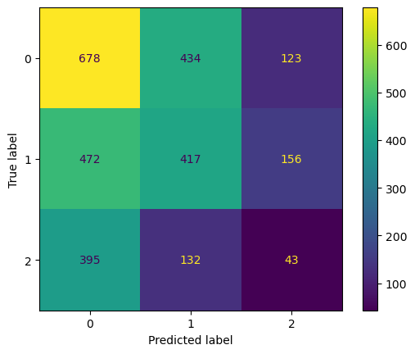
Test for new dataset (Trail 2)
ViT
Training Accuracy: 61.0074%, Training Loss: 0.84265842
Validation Accuracy: 41.1930%, Validation Loss: 1.12600279
Testing Accuracy: 39.9298%, Testing Loss: 1.17207851
Val: Test:

Slide 16
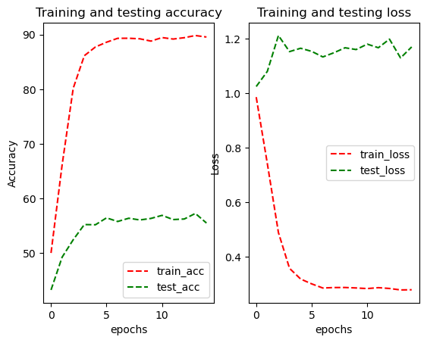
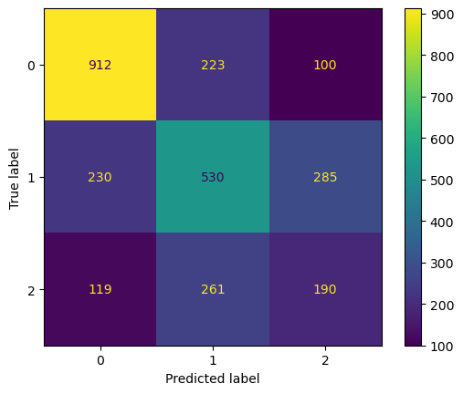
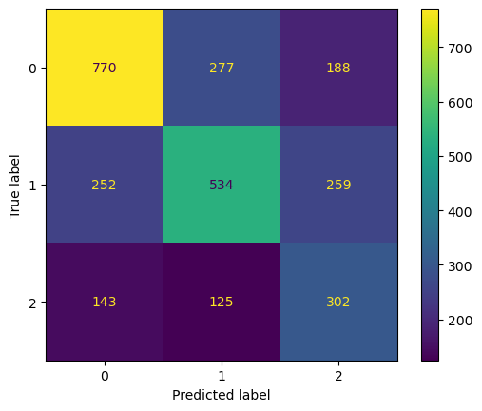
Test for new dataset (Trail 2)
Efficient Net
Training Accuracy: 89.8246%, Training Loss: 0.27791537
Validation Accuracy: 57.2632%, Validation Loss: 1.12869881
Testing Accuracy: 56.3509%, Testing Loss: 1.36861132
Val: Test:

Slide 17
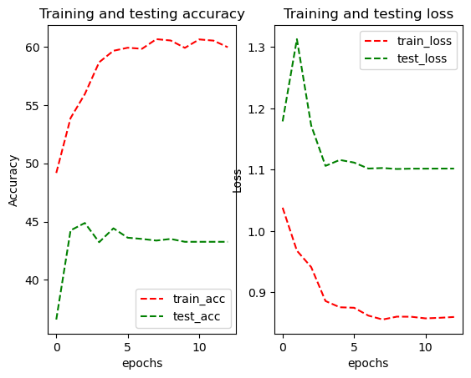
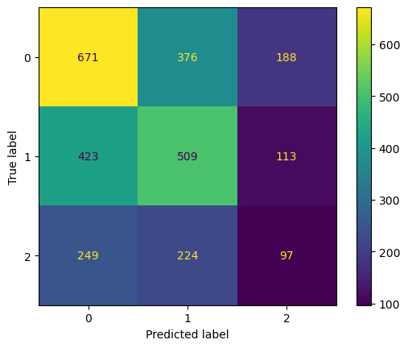
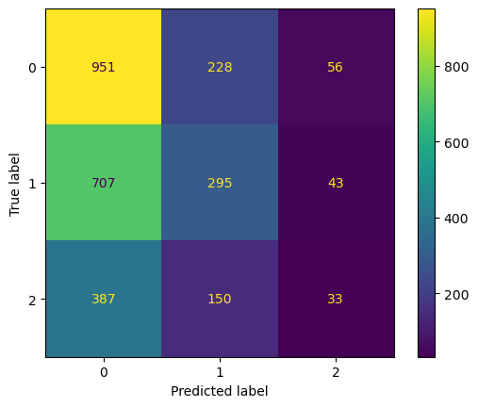
Test for new dataset (Trail 3)
ViT
Training Accuracy: 55.9366%, Training Loss: 0.94131951
Validation Accuracy: 44.8772%, Validation Loss: 1.17221839
Testing Accuracy: 44.8070%, Testing Loss: 1.09684327
Val: Test:

Slide 18
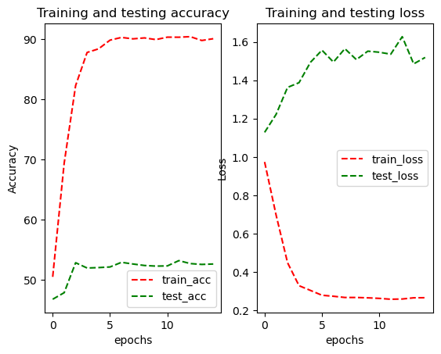
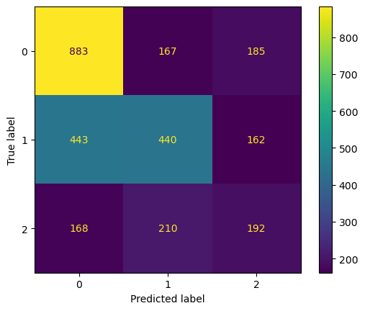
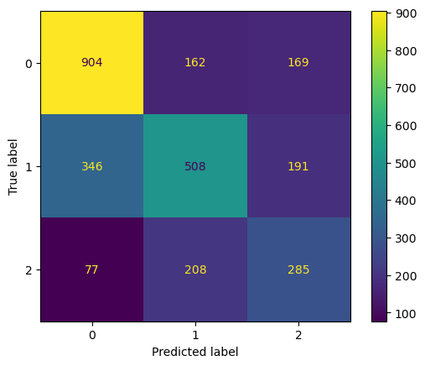
Test for new dataset (Trail 3)
Efficient Net
Training Accuracy: 90.3113%, Training Loss: 0.25852127
Validation Accuracy: 53.1579%, Validation Loss: 1.53561992
Testing Accuracy: 59.5439%, Testing Loss: 1.24602813
Val: Test:

Slide 19
Baseline for 1,2,3,4 year.
+- data augmentation and upsampling for the new dataset.

Slide 20
6/5

Slide 21
Efficient Net

Slide 22
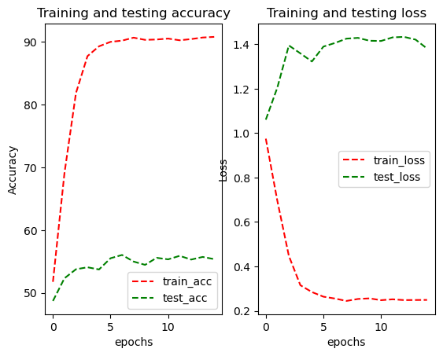
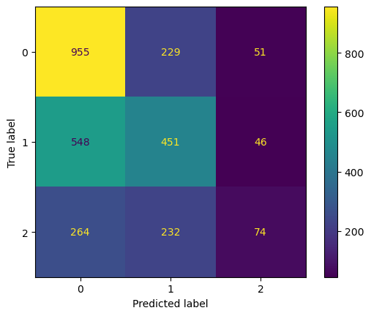
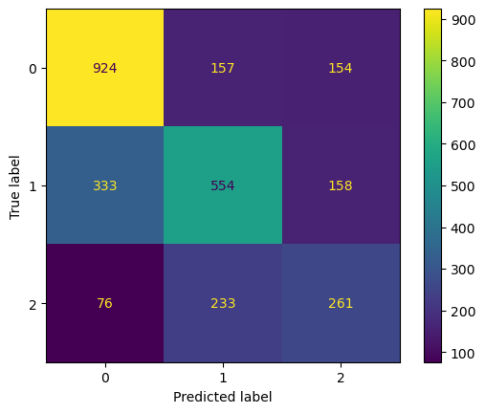
Base
Efficient Net
Training Accuracy: 90.2207%, Training Loss: 0.25533032
Validation Accuracy: 56.0351%, Validation Loss: 1.40603082
Testing Accuracy: 61.0175%, Testing Loss: 1.16426103
Val: Test:
Notes:
+2.0 %

Slide 23
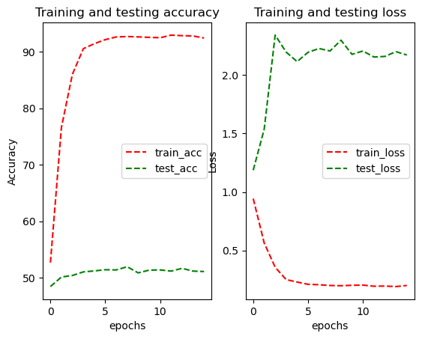
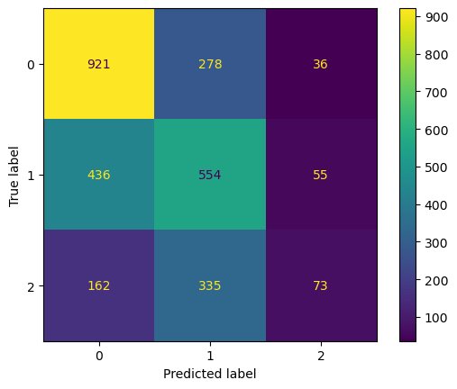
Upsampling method
SMOTE
Efficient Net
Training Accuracy: 92.7126%, Training Loss: 0.20011175
Validation Accuracy: 51.9298%, Validation Loss: 2.20665071
Testing Accuracy: 54.3158%, Testing Loss: 1.89822476
Val: Test:

Slide 24
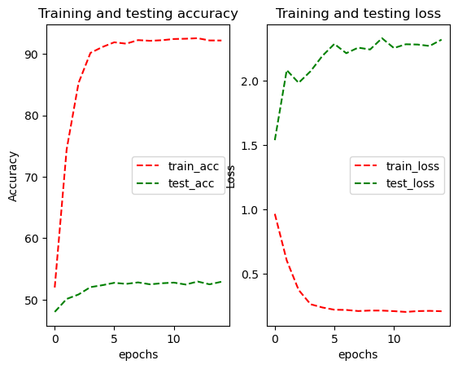
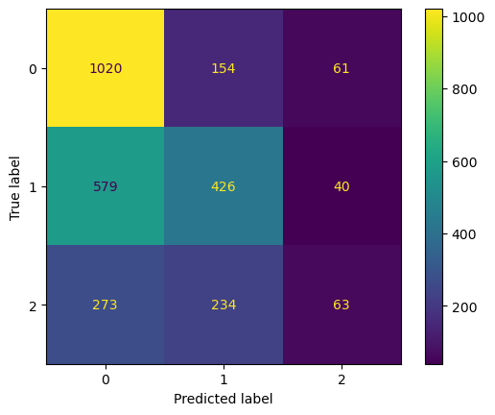
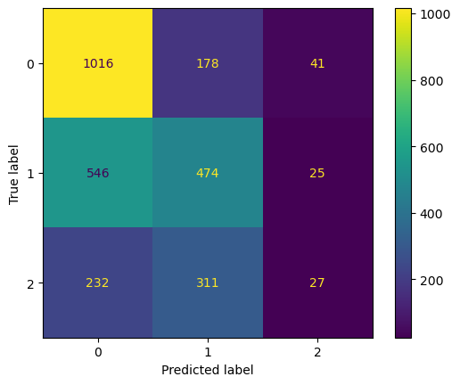
Upsampling method
SMOTE + ENN
Efficient Net
Training Accuracy: 92.5507%, Training Loss: 0.20858642
Validation Accuracy: 52.9474%, Validation Loss: 2.28358639
Testing Accuracy: 53.2281%, Testing Loss: 2.09202766
Val: Test:

Slide 25
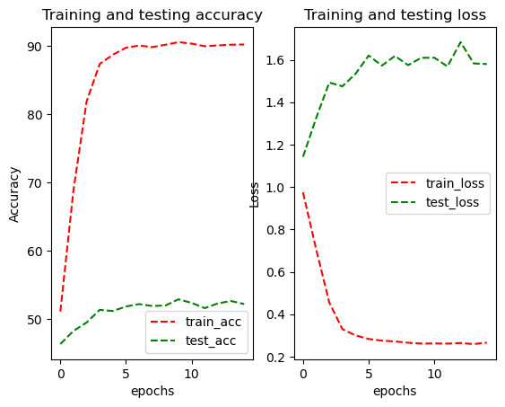
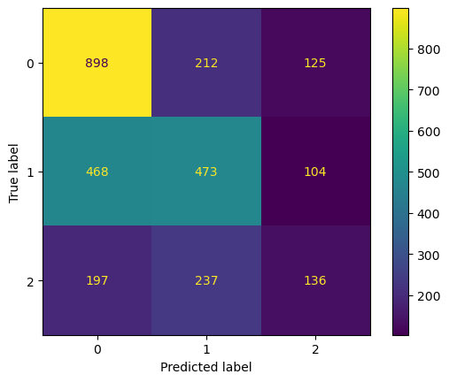
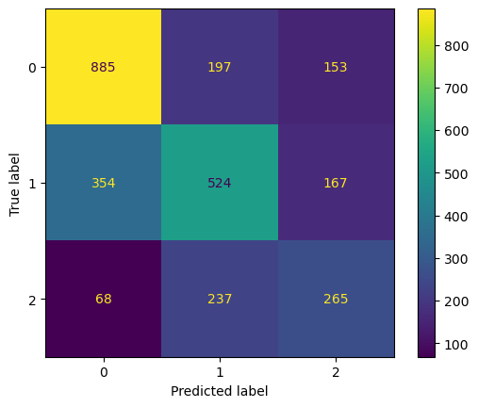
DA method
RandomApply( flip, rotate, brightness, contrast)
Efficient Net
Training Accuracy: 90.5942%, Training Loss: 0.26177135
Validation Accuracy: 52.8772%, Validation Loss: 1.60948780
Testing Accuracy: 58.7368%, Testing Loss: 1.21559799
Val: Test:

Slide 26
ViT

Slide 27
Upsampling method
Base
ViT
Training Accuracy: 55.9366%, Training Loss: 0.94131951
Validation Accuracy: 44.8772%, Validation Loss: 1.17221839
Testing Accuracy: 44.8070%, Testing Loss: 1.09684327
Val: Test:

Slide 28
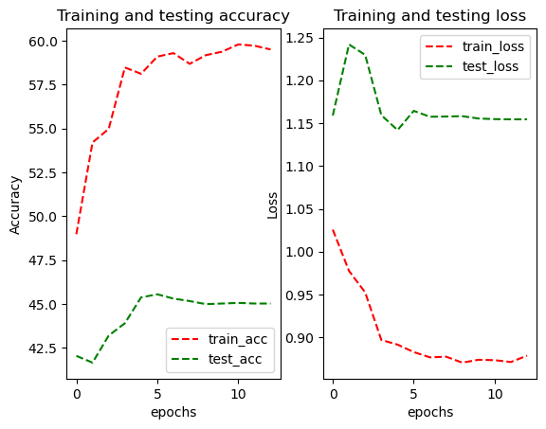
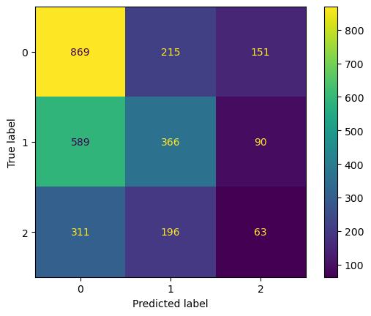

Upsampling method
SMOTE
ViT
Training Accuracy: 59.0913%, Training Loss: 0.88284417
Validation Accuracy: 45.5439%, Validation Loss: 1.16432022
Testing Accuracy: 40.2807%, Testing Loss: 1.23513258
Val: Test:

Slide 29



Upsampling method
SMOTE + ENN
ViT
Training Accuracy: 59.5583%, Training Loss: 0.88049123
Validation Accuracy: 45.1579%, Validation Loss: 1.14443192
Testing Accuracy: 40.9825%, Testing Loss: 1.23706600
Val: Test:

Slide 30



DA method
RandomApply( flip, rotate, brightness, contrast)
ViT
Training Accuracy: 48.6248%, Training Loss: 1.02788169
Validation Accuracy: 46.7018%, Validation Loss: 1.09256272
Testing Accuracy: 44.8772%, Testing Loss: 1.09868620
Val: Test:

Slide 31
Summary
Efficient Net | Base (%) | Smote (%) | Smote + ENN (%) | Data Augmentation | DA + upsampling
Val acc | 56 ± 1 | 52 ± 2 | 53 ± 3 | 54 ± 3 | 49 ± 4
Test acc | 61 ± 2 | 54 ± 1 | 53 ± 2 | 50 ± 4 | 51 ± 3
ViT | Base (%) | Smote (%) | Smote + ENN (%) | Data Augmentation | DA + upsampling
Val acc | 44 ± 3 | 46 ± 1 | 45 ± 3 | 46 ± 2 | 46 ± 3
Test acc | 44 ± 2 | 40 ± 3 | 40 ± 4 | 45 ± 3 | 40 ± 4
Notes:
Upsampling 39: 39:39

Slide 32
Swin transformer
Accuracy: all most same as the ViT (±3%)
Computing time: decrease 40% training time
Notes:
On Image 1k, 21k, swin improves 3% on testing accuracy
Hugging face: 2~4% depends on dataset

Slide 33
Classification recent model
Mamba
SS-Conv-SSM Block
KAN

Slide 34
7/28

Slide 35
Preprocessing
Dataset problem
Check the original image
Check the preprocess step by step
Trying to duplicate Olayinka's script
Resize, change orientation
Bias Field Correction
Brain Extraction
MNI Alignment
My preprocessing before input training
Data augmentation
Upsampling
Understand what will each preprocess gone affect the training

Slide 36
Training
Tracing the patient and index of slices
Accuracy vs each patient
Accuracy vs each number of slices
Detect whether there is a feature which can be used for predict

